Slide 1
WHAT IS CRED?
CRED is a members-only club that rewards individuals for their timely credit card bill payments by
providing them with exclusive offers and access to premium experiences. It is a platform that allows
credit card users to manage multiple cards along with an analysis of their credit score. Members
with a high Experian or CRIF score are eligible for exclusive rewards upon payment of their credit
card bills through the app. Among many of the features in the app are CRED's credit card spend
tracking and management feature which provided the user with analysis of spend tracking and
efficiency of usage of the card.

Slide 2
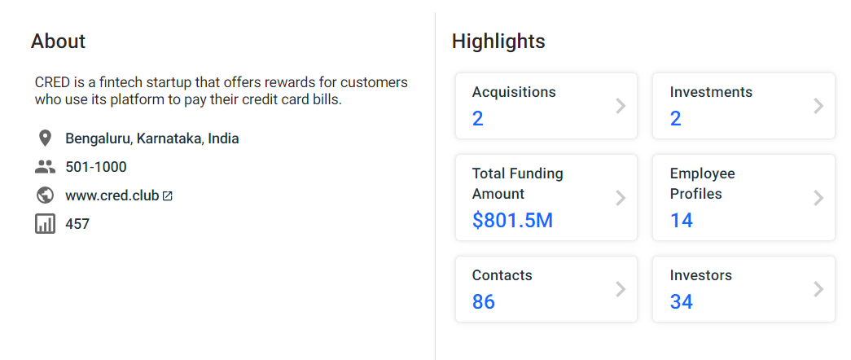

Slide 3
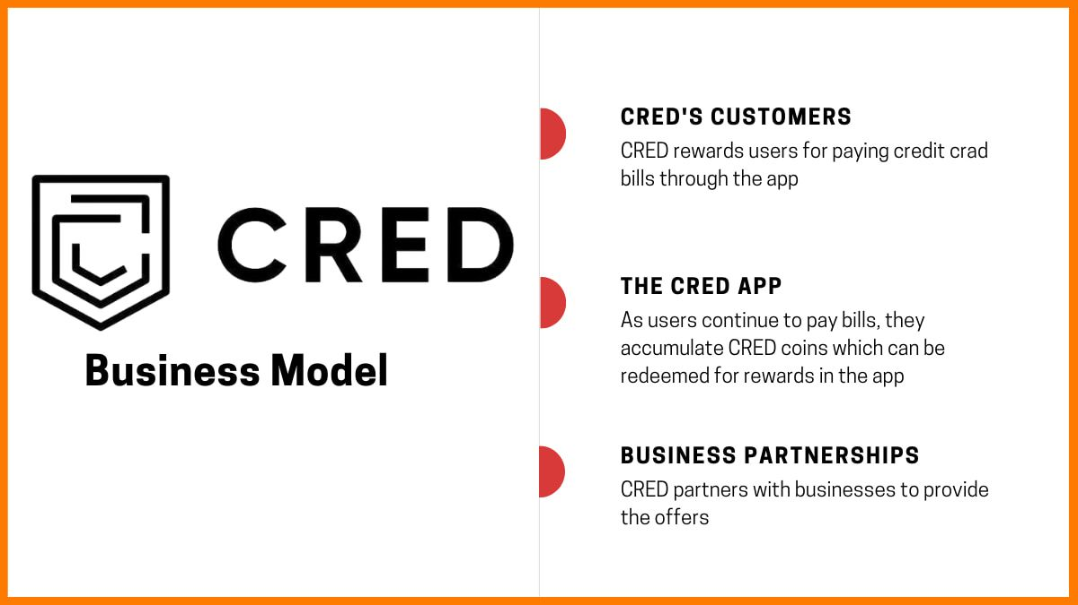

Slide 4
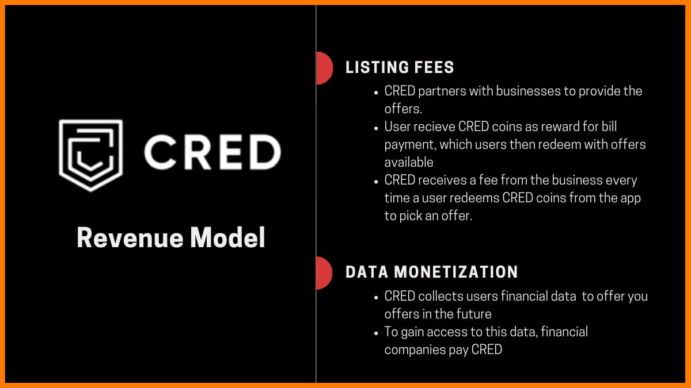

Slide 5
CRED has no single best source of revenue. CRED has a varied product/service span –
Rent pay, CRED Stash, Store, Credit Card Payments, and CRED Pay.

Slide 6
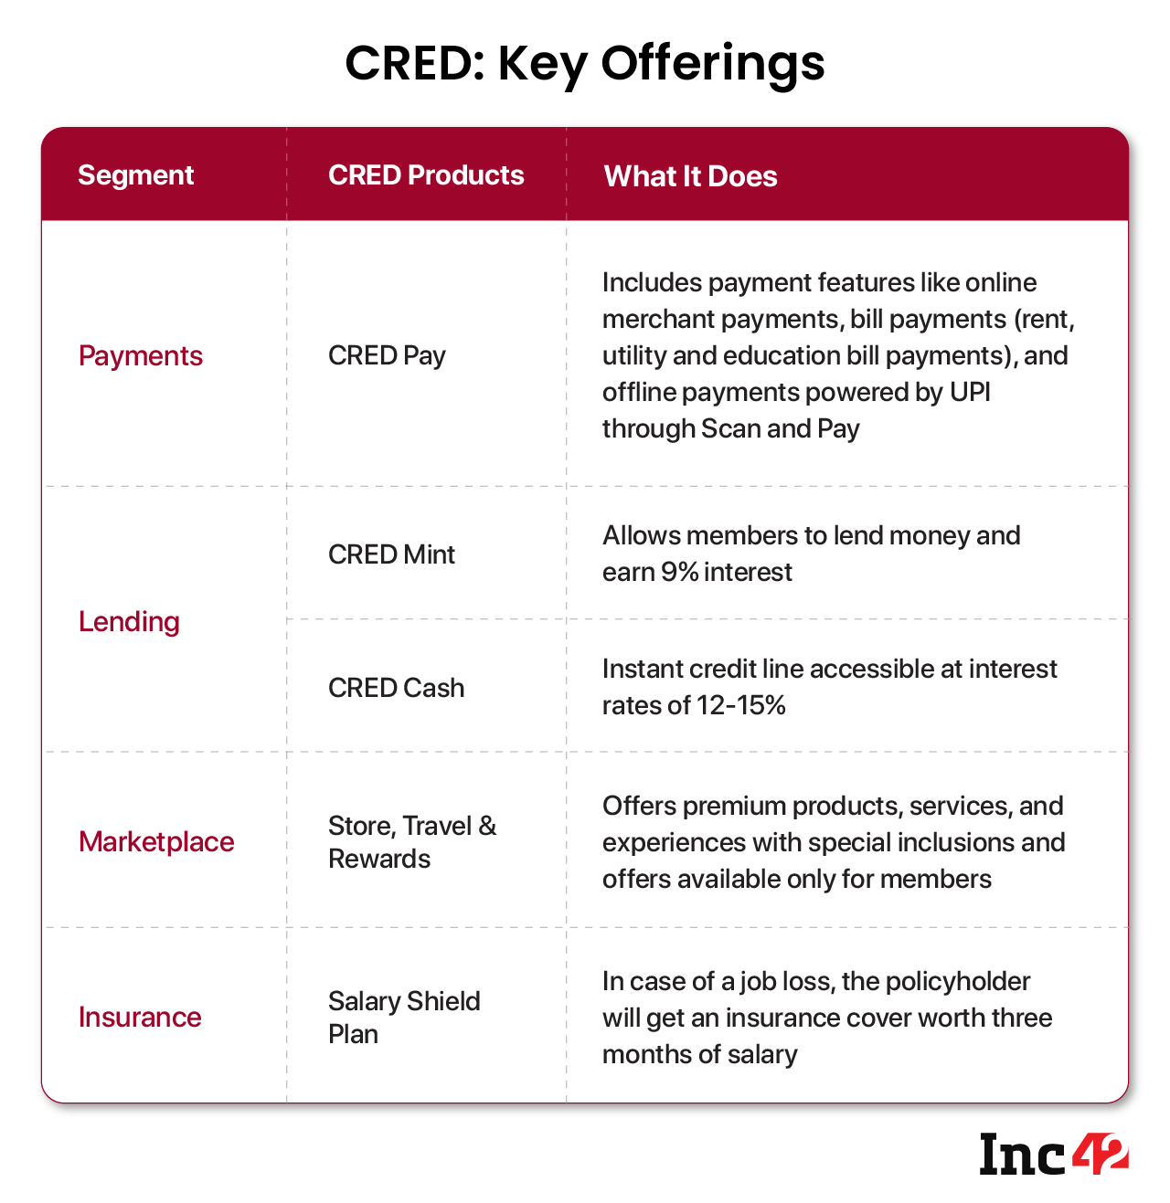

Slide 7
MARKETING
IPL Sponsorship
Viral marketing moves
Cred Mega Jackpot Week Campaign
Cred Powerplay Campaign
Mercedes GLC Coupe Giveaway

Slide 8
PRODUCT ANALYSIS
First — Solve a real user need and provide amazing convenience through the app. Credit card payment was
always difficult in India — especially if you didn’t have a savings/current bank account with the provider.
Secondly, as we often realize, having a useful product alone is not enough. Increasing adoption and
engagement is often the challenge. Reinforcement learning is a useful strategy for this.

Slide 9
Cred user Adoption Strategy:
Exclusivity (Create intrigue): Cred initially marketed as a members only app. And becoming a member gives
you certain exclusive benefits. This exclusivity brings with it a sense of intrigue and premium feeling to the app.
Over the years a similar strategy has been adopted by Gmail, Facebook to bring this sense of exclusivity and
intrigue through invite only growth in the beginning. A note for caution though is that ‘Exclusivity’ as a strategy
might not be ideal for every product- it has to tie into your larger business model. For Cred — they tied the
exclusivity based on a users credit score. Anyone with a score of above 750 could enter.So basically user with
a scrore 750+ will have good credit history and they are folks who use credit card often in India

Slide 10
Cred’s reinforcement mechanics :
Gems (Referral reward): Referral is also a common strategy used for increasing adoption across many products.
What Cred did here slightly differently was using reinforcement mechanics. Every referral got you ‘Gems’.
You could see your gems grow and you can sell these gems for cool rewards.
Coins: Every time someone uses the app to make payment — they earn cred coins. They could have made
1 Rupee = 1 Cred Coin. But to give a sense of higher earning, coins are awarded disproportionately higher than
the amount you pay for.

Slide 11
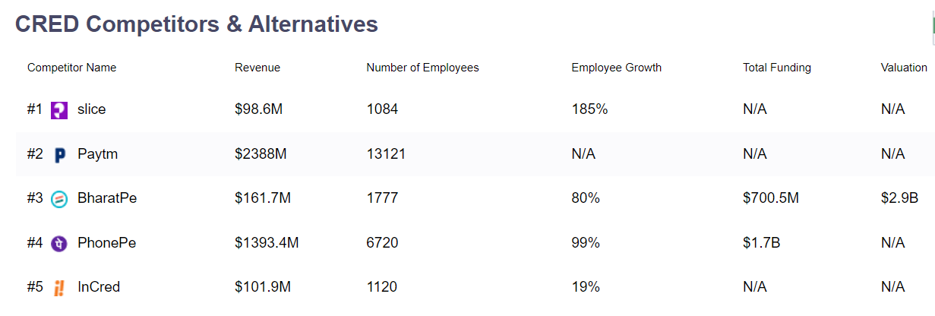

Slide 12
COMPTETION AND SUSTAINABILITY OF CRED
Catering to only members, CRED Scan & Pay does not seem to compete with apps like PhonePe and Gpay
rather aims to increase the level of engagement for existing users
With Mint, Cash and Salary Shield features, the company has already entered into the lending and insurance space.
The company’s revenue has increased from INR 18 Cr in FY20 to INR 95.5 Cr in FY21 while the total loss too
increased from INR 361 Cr to INR 524 Cr during the same periods.

Slide 13
What started as a credit card bill payments app in 2018 has expanded to CRED Pay for making utility bills,
CRED Mint for P2P lending, CRED Store, CRED Cash for loans and now Scan-and-Pay for UPI.
Scan & Pay, a UPI payment feature, is made available to CRED members only. Member eligibility involves having a
750 Experian score, so despite being UPI at the core, CRED’s Scan & Pay feature does not really compete with
other UPI apps. Those work for anyone and everyone who owns a mobile phone.
Unlike other UPI payments features, the company claims to offer certain unique features such as payments
protection, customisable experience and anonymous UPI. Besides providing the existing status of the transaction,
CRED is claiming 100% protection on every payment in case of failures.

Slide 14
Many of CRED’s users might themselves be so habituated to Paytm or Google Pay or PhonePe that the fact that
CRED has a UPI feature might not register immediately. So CRED has to continuously push for engagement through
marketing, notifications and more.
At the same time, the likes of Paytm, PhonePe, Amazon Pay and Google Pay already offer most features that CRED does,
including credit card bill payments, lending and much more.

Slide 15
The limited target market also limits the potential revenue streams for CRED, and also pose questions of
lack of scalability. “The idea is to increase the level of engagement and retain the members for a longer term, reducing
the CAC and increasing the ARPU,” said a company spokesperson.
CRED claims to offer a delightful and rewarding experience to users, which it says is the USP. While other apps do offer
similar rewards on every transaction, the term ‘delightful’ is subjective and does not necessarily mean deeper engagement
from the customer.
For instance, Flipkart and Paytm have a loyalty programme that is similar to CRED Coins.
But while Flipkart has 150 Mn products, CRED just has a few thousands in its catalogue.
So the question is: Is the CRED store with its limited shopping experience actually delightful?

Slide 16
THANK
YOU

